Slide 1
Bucket sort

Slide 2
Outline
The bucket sort makes assumptions about the data being sorted
Consequently, we can achieve better than Θ(n ln(n)) run times
We will look at:
a supporting example
the algorithm
run times (no best-, worst-, or average-cases)
summary and discussion

Slide 3
Supporting example
7.7.1
Suppose we are sorting a large number of local phone numbers, for example, all residential phone numbers in the 416 area code region (approximately four million)
We could use quick sort, however that would require an array which is kept entirely in memory

Slide 4
Supporting example
7.7.1
Instead, consider the following scheme:
Create a bit vector with 10 000 000 bits
This requires 10⁷/1024/1024/8 ≈ 1.2 MiB
Set each bit to 0 (indicating false)
For each phone number, set the bit indexed by the phone number to 1 (true)
Once each phone number has been checked, walk through the array and for each bit which is 1, record that number

Slide 5
Supporting example
7.7.1
For example, consider this section within the bit array
⋮ | ⋮
6857548
6857549
6857550
6857551
6857552
6857553
6857554
6857555
6857556
6857557
6857558
6857559
6857560
6857561
6857562
⋮ | ⋮

Slide 6
Supporting example
7.7.1
For each phone number, set the corresponding bit
For example, 685-7550 is a residential phone number
⋮ | ⋮
6857548 | ✔
6857549 | ✔
6857550
6857551
6857552
6857553 | ✔
6857554
6857555 | ✔
6857556
6857557
6857558 | ✔
6857559
6857560
6857561 | ✔
6857562 | ✔
⋮ | ⋮

Slide 7
Supporting example
7.7.1
For each phone number, set the corresponding bit
For example, 685-7550 is a residential phone number
⋮ | ⋮
6857548 | ✔
6857549 | ✔
6857550 | ✔
6857551
6857552
6857553 | ✔
6857554
6857555 | ✔
6857556
6857557
6857558 | ✔
6857559
6857560
6857561 | ✔
6857562 | ✔
⋮ | ⋮

Slide 8
Supporting example
7.7.1
At the end, we just take all the numbers out that were checked:
…, 685-7548, 685-7549, 685-7550,
685-7553, 685-7555, 685-7558,
685-7561, 685-5762, …
⋮ | ⋮
6857548 | ✔
6857549 | ✔
6857550 | ✔
6857551
6857552
6857553 | ✔
6857554
6857555 | ✔
6857556
6857557
6857558 | ✔
6857559
6857560
6857561 | ✔
6857562 | ✔
⋮ | ⋮

Slide 9
Supporting example
7.7.1
In this example, the number of phone numbers (4 000 000) is comparable to the size of the array (10 000 000)
The run time of such an algorithm is Θ(n):
we make one pass through the data,
we make one pass through the array and extract the phone numbers which are true

Slide 10
Algorithm
7.7.2
This approach uses very little memory and allows the entire structure to be kept in main memory at all times
We will term each entry in the bit vector a bucket
We fill each bucket as appropriate

Slide 11
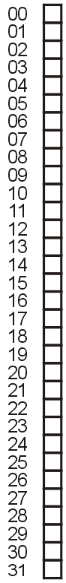
Example
7.7.3
Consider sorting the following set of unique integers in the range 0, ..., 31:
20 1 31 8 29 28 11 14 6 16 15
27 10 4 23 7 19 18 0 26 12 22
Create an bit-vector with 32 buckets
This requires 4 bytes

Slide 12
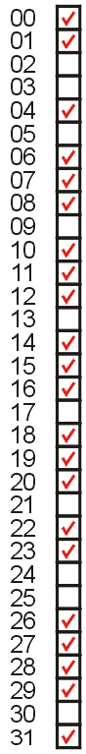
Example
7.7.3
For each number, set the corresponding bucket to 1
Now, just traverse the list and record only those numbers for which the bit is 1 (true):
0 1 4 6 7 8 10 11 12 14 15
16 18 19 20 22 23 26 27 28 29 31

Slide 13
Analysis
7.7.3
How is this so fast?
An algorithm which can sort arbitrary data must be Ω(n ln(n))
In this case, we don’t have arbitrary data: we have one further constraint, that the items being sorted fall within a certain range
Using this assumption, we can reduce the run time

Slide 14
Counting sort
7.7.4
Modification: what if there are repetitions in the data
In this case, a bit vector is insufficient
Two options, each bucket is either:
a counter, or
a linked list
The first is better if objects in the bin are the same

Slide 15
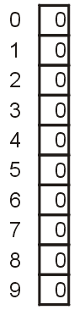
Example
7.7.4
Sort the digits
0 3 2 8 5 3 7 5 3 2 8 2 3 5 1 3 2 8 5 3 4 9 2 3 5 1 0 9 3 5 2 3 5 4 2 1 3
We start with an array of 10 counters, each initially set to zero:

Slide 16
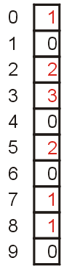
Example
7.7.4
Moving through the first 10 digits
0 3 2 8 5 3 7 5 3 2 8 2 3 5 1 3 2 8 5 3 4 9 2 3 5 1 0 9 3 5 2 3 5 4 2 1 3
we increment the corresponding buckets

Slide 17
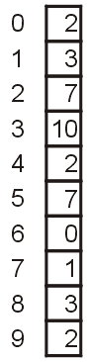
Example
7.7.4
Moving through remaining digits
0 3 2 8 5 3 7 5 3 2 8 2 3 5 1 3 2 8 5 3 4 9 2 3 5 1 0 9 3 5 2 3 5 4 2 1 3
we continue incrementing the corresponding buckets

Slide 18
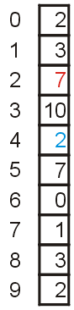
Example
7.7.4
We now simply read off the number of each occurrence:
0 0 1 1 1 2 2 2 2 2 2 2 3 3 3 3 3 3 3 3 3 3 4 4 5 5 5 5 5 5 5 7 8 8 8 9 9
For example
There are seven 2s
There are two 4s

Slide 19
Run-time summary
7.7.5
The following table summarizes the run-times of bucket sort which will always require Θ(m) memory
Case | Run Time | Memory | Comments
Worst | Θ(m) | ω(n) | m = ω(n)
Average | Θ(n + m) | Θ(m)
Best | Θ(n) | ο(n) | m = ο(n)

Slide 20
Run-time summary
7.7.5
We must assume that the number of items being sorted is comparable to the possible number of values
For example, if we were sorting n = 20 integers from 1 to one million, bucket sort may be argued to be Θ(n + m), however, in practice, it may be less so

Slide 21
Summary
By assuming that the data falls into a given range, we can achieve Θ(n) sorting run times
As any sorting algorithm must access any object at least once, the run time must be Θ(n)
It is possible to use bucket sort in a more complex arrangement in radix sort if we want to keep down the number of buckets

Slide 22
References
Wikipedia, http://en.wikipedia.org/wiki/Bucket_sort
[1] Donald E. Knuth, The Art of Computer Programming, Volume 3: Sorting and Searching, 2nd Ed., Addison Wesley, 1998, §5.1, 2, 3.
[2] Cormen, Leiserson, and Rivest, Introduction to Algorithms, McGraw Hill, 1990, p.137-9 and §9.1.
[3] Weiss, Data Structures and Algorithm Analysis in C++, 3rd Ed., Addison Wesley, §7.1, p.261-2.
[4] Gruber, Holzer, and Ruepp, Sorting the Slow Way: An Analysis of Perversely Awful Randomized Sorting Algorithms, 4th International Conference on Fun with Algorithms, Castiglioncello, Italy, 2007.
These slides are provided for the ECE 250 Algorithms and Data Structures course. The material in it reflects Douglas W. Harder’s best judgment in light of the information available to him at the time of preparation. Any reliance on these course slides by any party for any other purpose are the responsibility of such parties. Douglas W. Harder accepts no responsibility for damages, if any, suffered by any party as a result of decisions made or actions based on these course slides for any other purpose than that for which it was intended.

